Slide 1
Machine Learning
Introduction to the artistic science of all times
By: Faris Hassan

Slide 2


Slide 3
If else intelligence

Slide 4
Rise of Learning

Slide 5
What is Machine Learning?

Slide 6
Arthur 1959
is the subfield of computer science that gives computers the ability to learn without being explicitly programmed.

Slide 7
Tom Mitchel 1997
A computer program is said to learn from experience E with respect to some class of tasks T and performance measure P if its performance at tasks in T, as measured by P, improves with experience E.

Slide 8
Sequential Logic
Input
Processing
output

Slide 9
Machine Learning Logic
New Input
Output
Input/
examples
Output/
labels
Training
Model

Slide 10
Types of Learning problems
Supervised learning
Unsupervised learning
Reinforcement learning

Slide 11
Supervised Learning
Classification
Regression
Supervised Learning

Slide 12
Supervised Learning Diagram
Training
Model
New input
input
output
input
output
input
output
input
output
input
output
input
output
Output

Slide 13
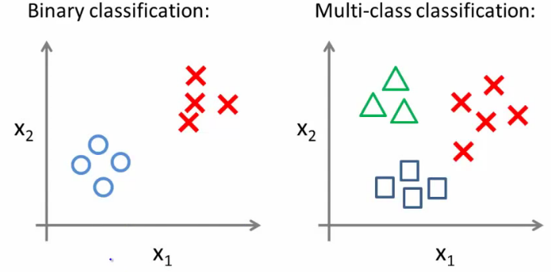

Slide 14
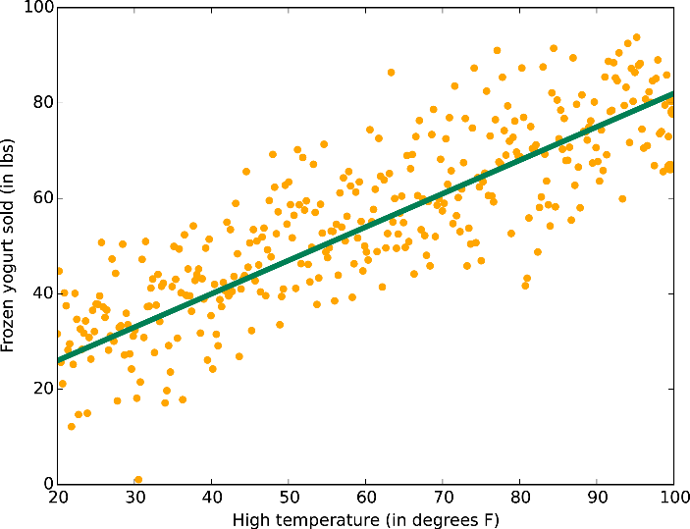

Slide 15
Unsupervised Learning
Dealing with data of unknown structure and we rely on the intelligence of the machine to explore the structure of the data to derive meaningful information independent from human guidance or reward function.

Slide 16
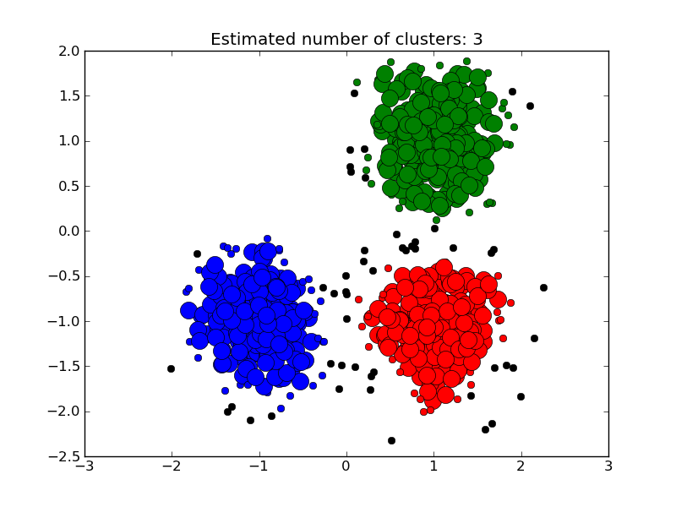

Slide 17
Types of Machine Learning Algorithms
ML Algorithms
Probabilistic
Linear
Tree Based
Evolutionary

Slide 18
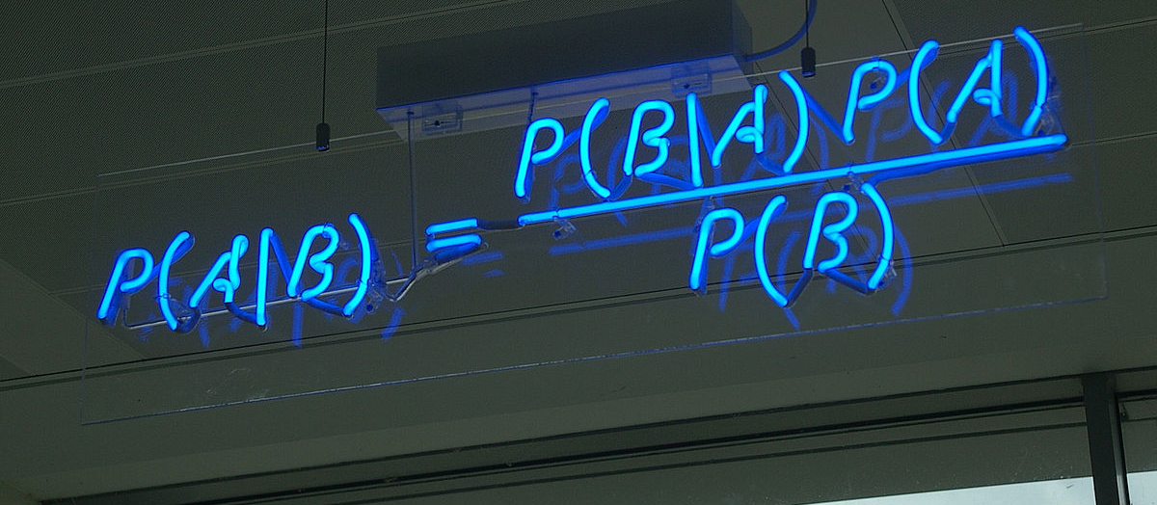
Probabilistic

Slide 19
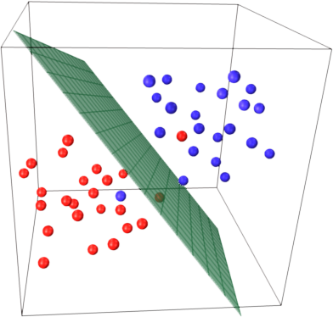
Linear Classification

Slide 20
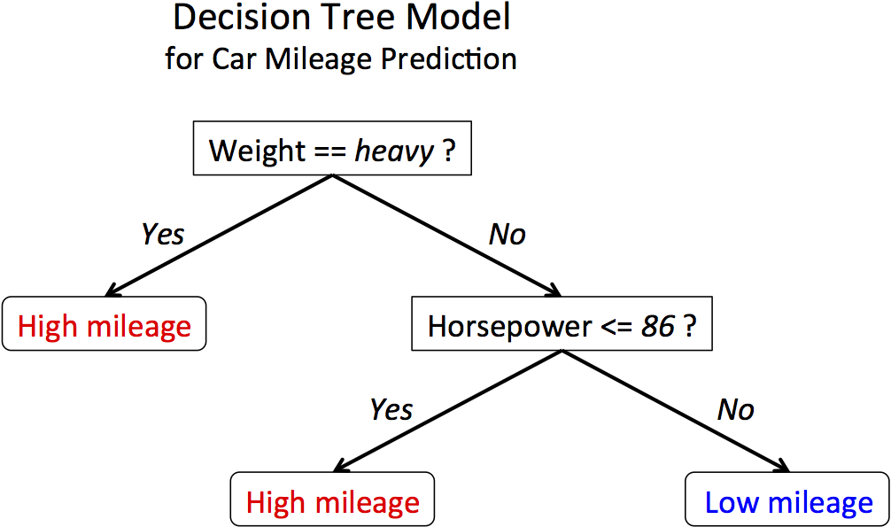
Tree Based

Slide 21
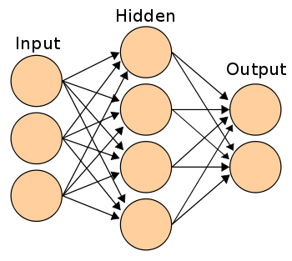
Artificial neural Network

Slide 22
How does Learning happen ?

Slide 23

Y $=f\left(w.x\right)=f\left( \sum{j}wj.xj\right)$

Slide 24

Learning in ACTION
Loss function
Objective function
regularize

Slide 25
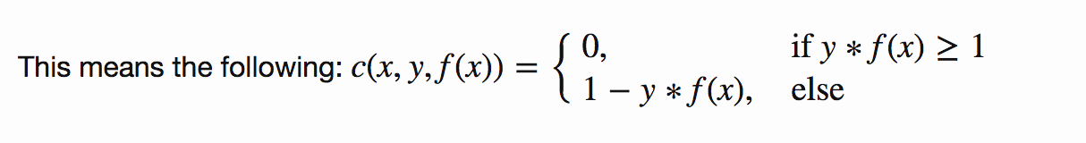
Hinge Loss Function
c(x,y,f(x)) = (1 - y*f(x))+

Slide 26
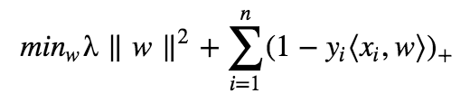
Objective Function

Slide 27
How Does these things work together ?
Gradient ducking Decent
Do you want to know that too ?

Slide 28
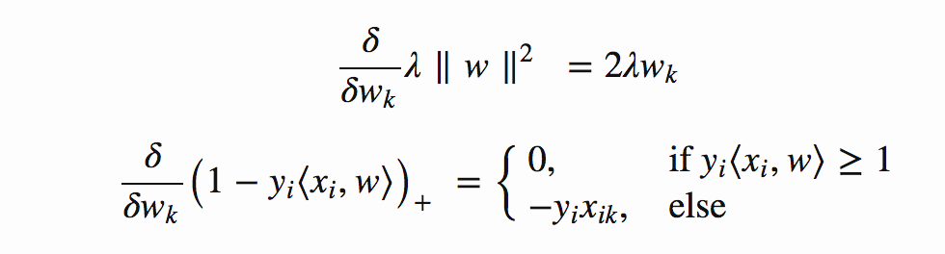
F****G calculous in ACTION

Slide 29

If classification is wrong
Misclassification conditional statement :

Slide 30


The sexy learning is triggered
Misclassification:
Correct classification:

Slide 31
Should I know this ?
Screw it just type:
From sklearn import linear_model
Clf = linear_model.LinearRegression()
Clf.fit(x, y)

Slide 32
Why ?

Slide 33
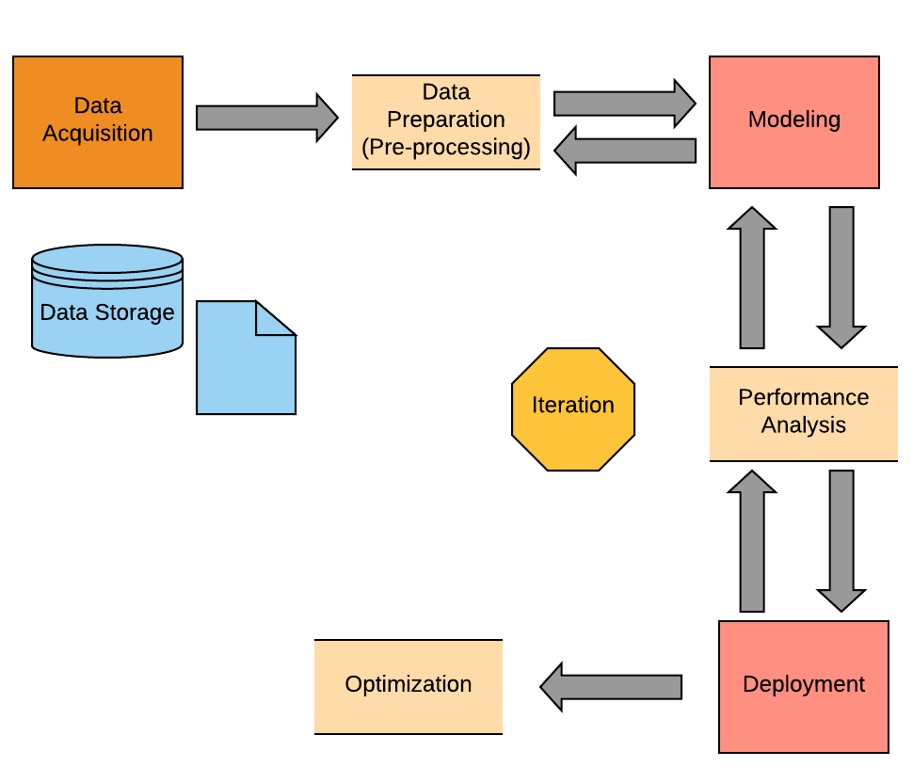
Machine Learning cycle

Slide 34
NO DATA NO DEAL

Slide 36


Get to your momentum and GROW

